Slide 1
Teaching Russian Society and Culture: A Few Approaches
Dr. Alistair Dickins (Cheadle Hulme Sixth Form)

Slide 2
Society and Culture
Key Questions
  Who do we mean when we say “Russians” (or “Soviets”)?
  What did it mean to be part of great (revolutionary) events?
  What agency did “ordinary people” have?
  How were changes in Russian and Soviet history reflected in culture?
Resource Foci
  “Ordinary People” in 1917 Revolution
  Nationalities under Stalin
  The Siege of Leningrad, 1941-43

Slide 3
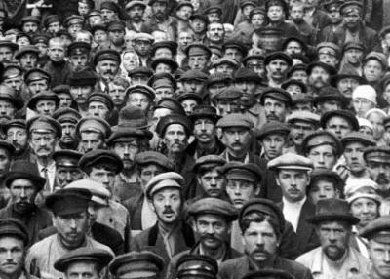
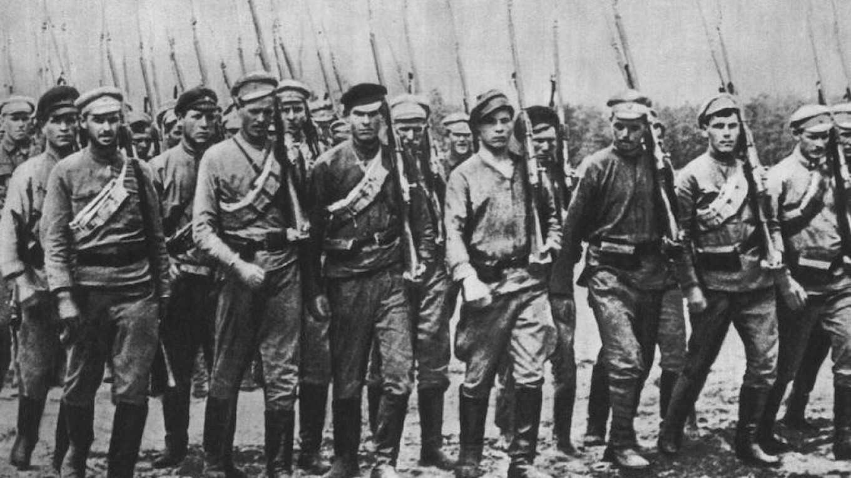
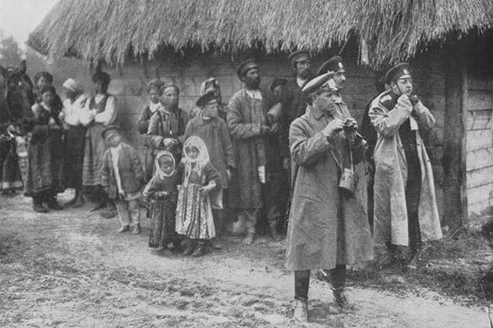
‘Ordinary People’
Historians have typically focused on three social groups in the 1917 Revolution.
  Workers
  Soldiers
  Peasants
But who are these, exactly?
Ordinary People in the 1917 Revolution

Slide 4
The Simplest Schema
Workers | Soldiers | Peasants
Work, wages, and bread | Peace | Land
Except, except, except, except, except...
Historians today point out that there are at least as many exceptions to this schema as there are "rules" in favour of it!
Ordinary People in the 1917 Revolution

Slide 5
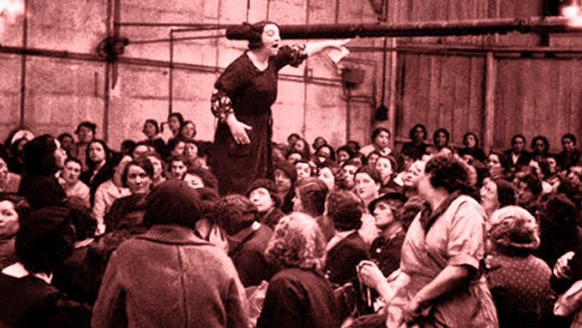
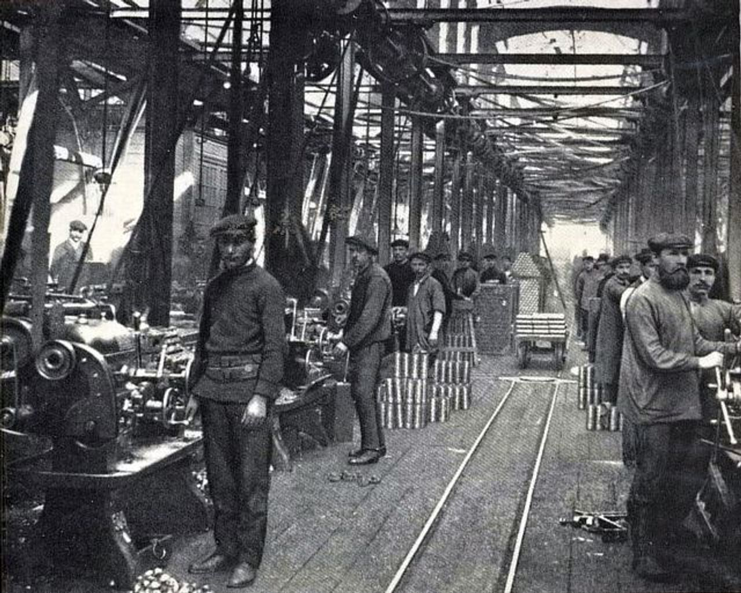
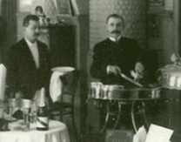
Ordinary People?
Look at the pictures on the cards in front of you.
Can you sort these people into groups, based on who they appear to be?
  Workers?
  Soldiers?
  Peasants?
  Others?
Now turn your cards over.
Sort them into new categories.
Ordinary People in the 1917 Revolution

Slide 6
Redrawing the Schema
Workers | Soldiers | Peasants
Work, wages, and bread | Peace | Land
Look back over this schema.
How could you modify it to better reflect the reality of revolution, as experienced by “ordinary people”?
Ordinary People in the 1917 Revolution

Slide 7
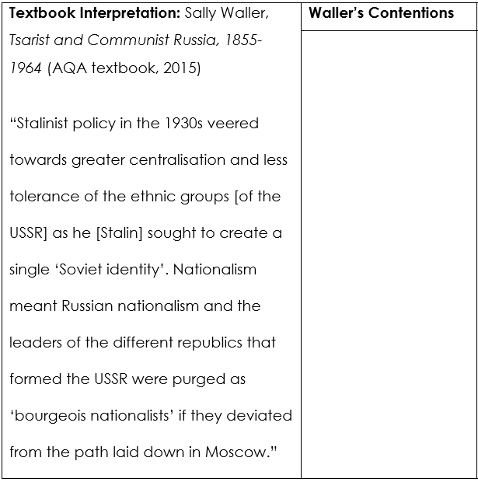
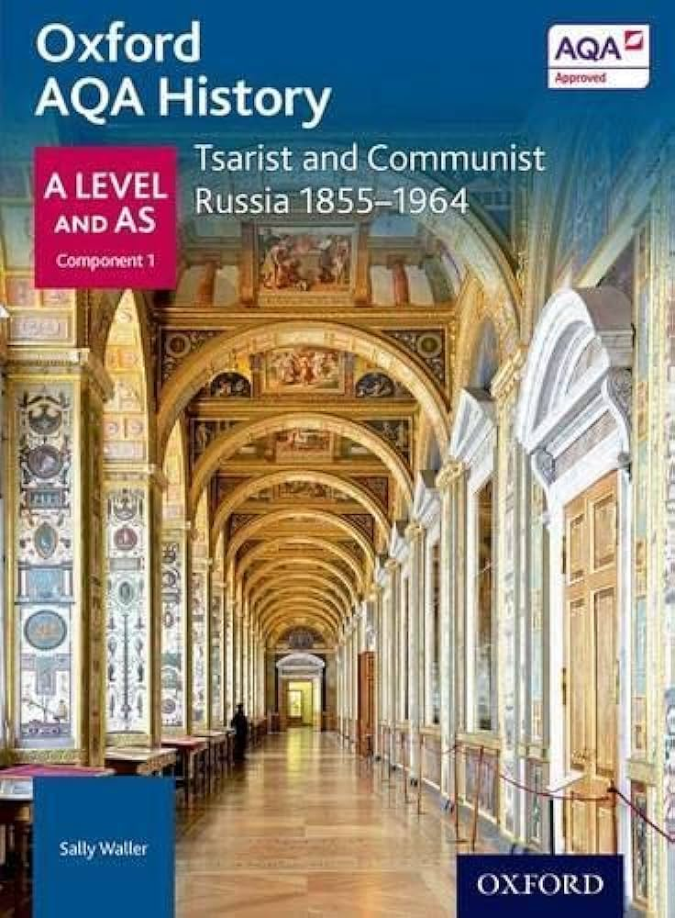
A Textbook Interpretation
The AQA textbook gives this account of nationalism in the 1930s
Today, we are going to consider how accurate this interpretation is
First, read carefully through Sally Waller’s account. What are her main contentions?
Nationalities under Stalin, 1930s

Slide 8
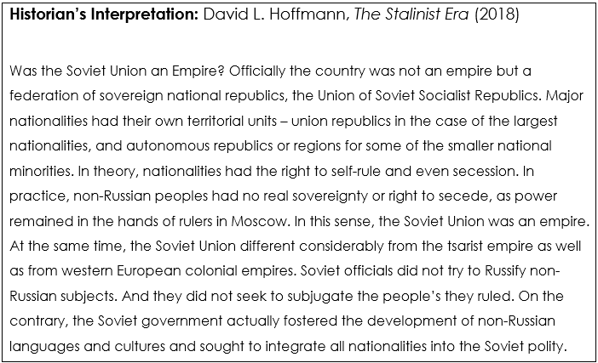
A Historian’s Interpretation
Nationalities under Stalin, 1930s

Slide 9
Pro-nationalist
Pro-non Russians
Pro-Russian
Anti-nationalist
Nationalities under Stalin, 1930s

Slide 10
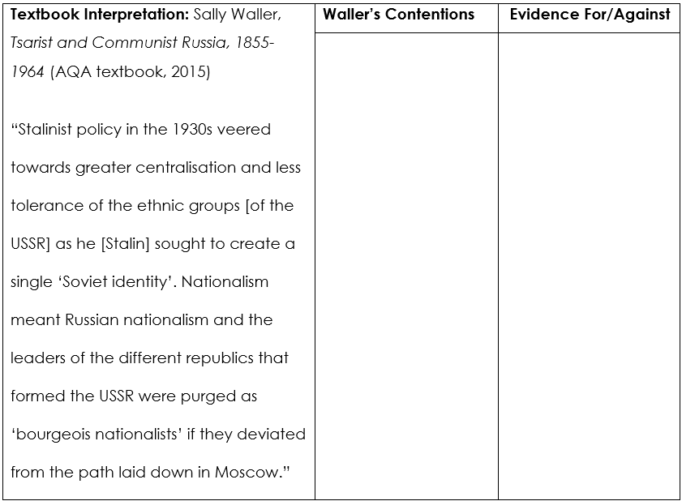
Revising the Textbook
We began this lesson with Waller’s interpretation from the AQA textbook
Consider what evidence we now have that supports and challenges this interpretation
You now have 5 minutes to re-write the textbook interpretation, bringing it up to date with historical research
Nationalities under Stalin, 1930s

Slide 11
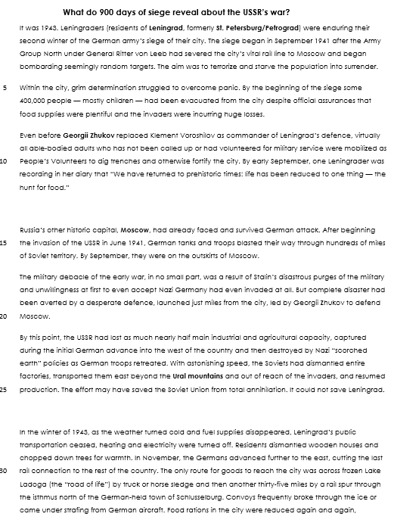
What do 900 days of siege reveal?
Read the story of Leningrad’s siege.
What does it reveal about war’s significance for Russia’s people?
The Siege of Leningrad, 1941-44

Slide 12
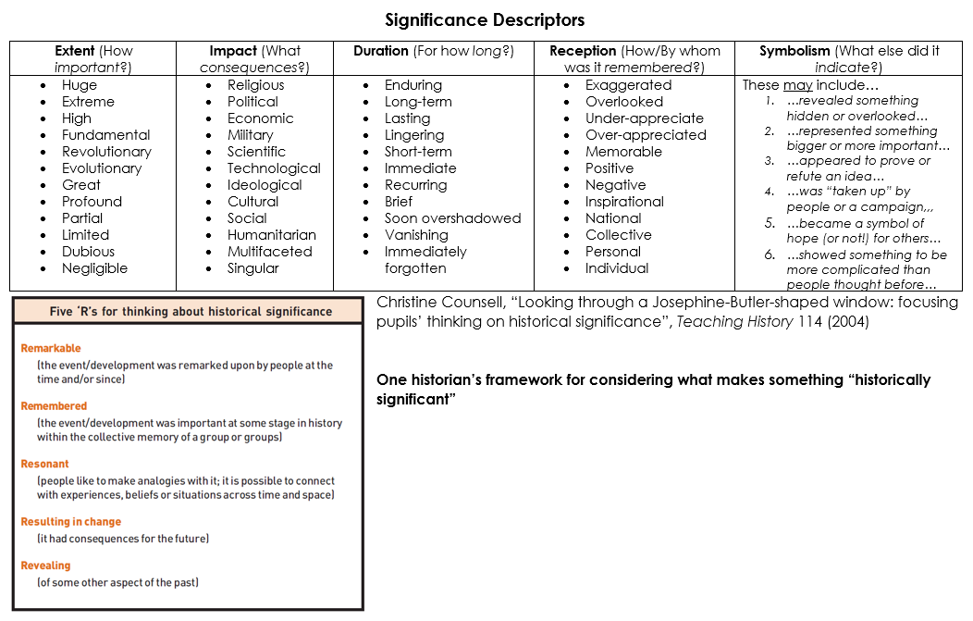
The Siege of Leningrad, 1941-44

Slide 13



More Thoughts and Resources
Twitter @ADIDickins
Istorik Blog:
  Twitter - @IstorikBlog
  Facebook – Istorik: Russian and Soviet History in the Classroom

