Slide 1
Russia’s Civil War
Geoffrey Swain
Professor Emeritus, University of Glasgow

Slide 2
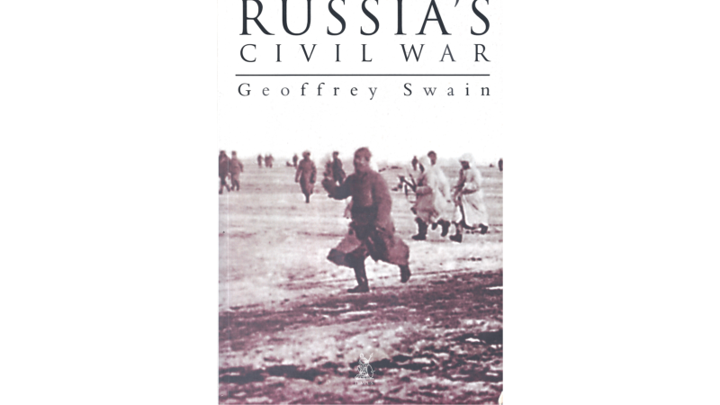

Slide 3
My book
Published by Tempus in 2000, I start the book with a quote from Sir Paul Dukes, who as British Secret Agent ‘ST25’ provided information to Whitehall from Petrograd throughout the civil war. He recalled:
“It must never be forgotten that in the Russian revolutionary wars there were three parties in the struggle – the Reds, the ‘Whites’ and the People – and that, as much as the populace detested the Red regime in its earliest form, they came, during the revolutionary wars, to regard the ‘Whites’ with even greater repugnance.”
For Dukes, Russia’s civil war was a three-way struggle – and I would agree. There are three phases to this three-way struggle.

Slide 4
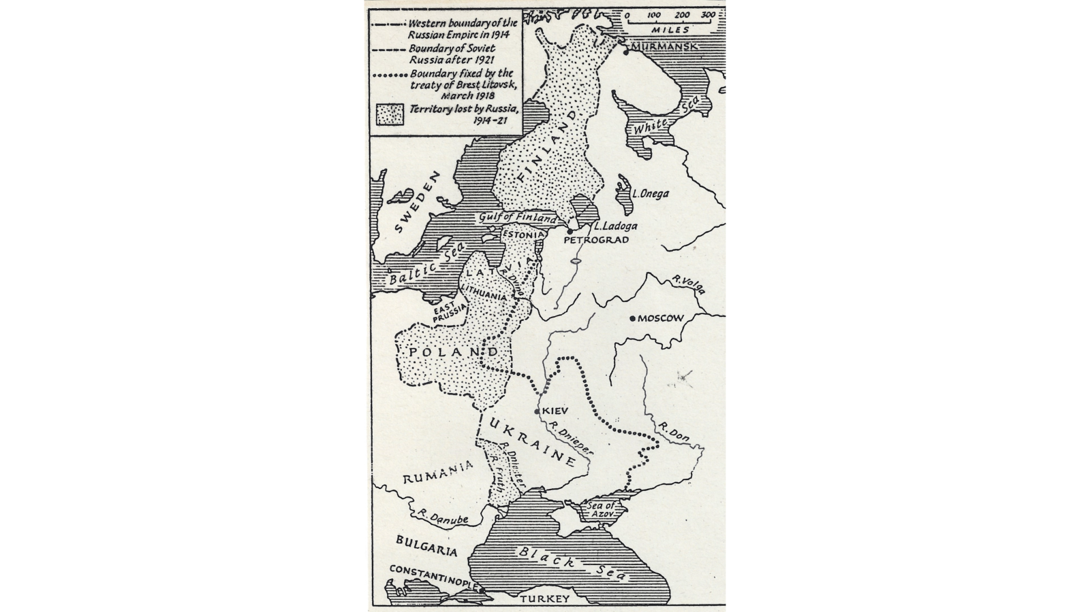
Phase One: The War with the SRs, the Democratic Counter-revolution
The SRs won the Constituent Assembly elections, which assembled and was dissolved at the start of January 1918.
Together, the Bolsheviks and Left SRs won the elections to the Third Congress of Soviets, which assembled in mid-January 1918.
Two rival democratic mandates.
However, in spring 1918 the big issue was not these January elections but the Brest-Litovsk Peace. Would it be signed? Would it last? Would the Germans honour it?

Slide 6
It was only in May 1918, when a German ambassador had arrived in Moscow, and it was clear that the Treaty of Brest Litovsk was here to stay that the SRs decided that the time had come to take up arms against the Bolsheviks.
This decision coincided with the ‘mutiny’ of the Czechoslovak Legion.
Formed from Czech and Slovak POWs from the Austrian Army, the Czechoslovak Legion had been based near Kiev. As the German Army occupied Ukraine, so the Legion started to move towards Siberia and the Far East by train.
Under pressure from the German ambassador, the Bolsheviks agreed to disarm the Legion, issuing an order to this effect on 15 May. On 21 May a conference of the Legion voted to resist disarmament and continue its journey by force if necessary.
Large sections of the Legion were spread along the railways crossing the Volga region. The SRs realised the Legion’s new hostility to the Bolsheviks could be of help to them.

Slide 7
At the very start of June 1918, the SR Constituent Assembly deputies for Samara formed an insurrectionary militia and made contact with the Czechoslovaks. On 8 June, in a joint action, Samara was seized and the SRs announced the formation of a new anti-Bolshevik Government, the Committee of the Constituent Assembly (Komuch).
Komuch quickly formed a People’s Army. On 22 July it captured Simbirsk and by 10 August Kazan had fallen – Kazan was the town to which the Bolsheviks had evacuated the state treasury.
On 2 August the British landed in Archangel – as Trotsky recalled, Soviet power hung by a thread.

Slide 8
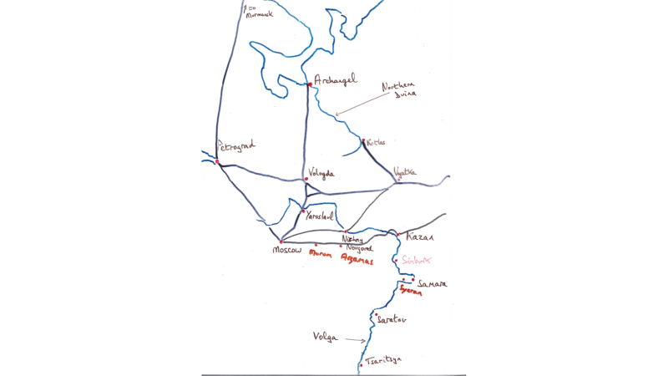

Slide 9
With Trotsky at the head of an armed flotilla, the Red Army managed to recapture Kazan on 8 September.
Komuch retreated from Samara to Ufa, and ultimately to Omsk.
As it did so, the SRs rather reluctantly decided to form a coalition government with the liberals.
But this concession enabled them to reorganise their People’s Army and by the start of November it was the turn of the Red Army to retreat.
In particular, the Red Army was defeated at Belebei, reporting on 10 November “the enemy has launched an offensive with overwhelming force at Kandry station”, near the junction of the Simbirsk and Samara railway lines.

Slide 10
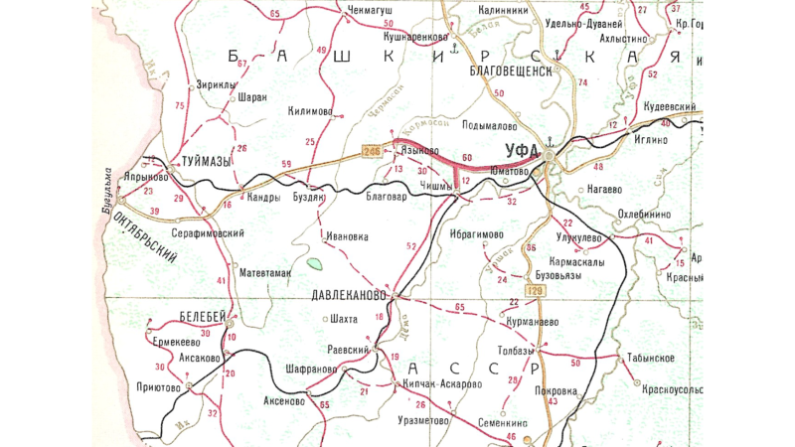

Slide 11
Phase Two: The War against White Counter-revolution
Just as the People’s Army seemed to be turning the tables on the Red Army, during the night of 17-18 November Admiral Kolchak staged a coup in Omsk and overthrew Komuch, arresting and executing many SRs and establishing his dictatorship.
Although the official stance of the SR Party was to be neutral in this new phase of the civil war, a major SR faction ‘the Ufa delegation’ decided to work with the Bolsheviks and against the Whites.
The People’s Army either dissolved its units into the Siberian Army of Kolchak, or moved west and joined the Red Army.
The Civil War was now about counter-revolution, not the return of the Tsar but the formation of a ‘firm government’.
In White territory the rights of democratic bodies were curtailed and organisations like trade unions persecuted. Land, although not all land, would be restored to landlords, with peasants paying for the land allocated to them.

Slide 12
A month after seizing power, Kolchak began to advance in mid-December along the Trans-Siberian railway, aiming for Perm and then Vyatka, where he hoped for a rendez-vous with the British. Perm was taken on 24-25 December.
However, further south, the merger of the Red Army with units of the People’s Army had enabled Ufa to be taken by the Reds.
On 3 March 1919 Kolchak renewed his offensive, making slow progress towards Vyatka, but much better progress in the south, where Ufa changed hands again as his forces neared the Volga.
Then they stalled. By May a retreat had begun and by early June Ufa was in Red hands again. Further north, Vyatka had still not been taken by the start of June, and a fortnight later Kolchak’s troops were back in Perm, which the Red Army retook on 1 July.
By mid-July all the mines, factories and railways of the Urals were back in Bolshevik hands.

Slide 13
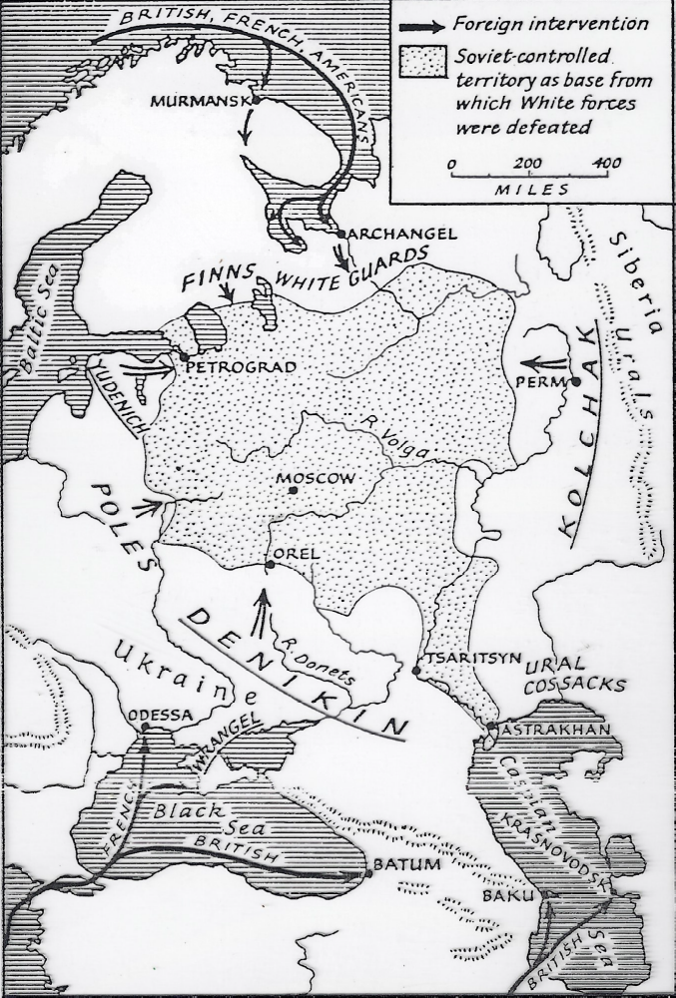

Slide 14
In summer 1919 the main focus of the Civil War turned to the south. The end of the First World War meant that British ships could sail into the Black Sea, far easier than sailing to Archangel or Vladivostok. General Denikin, while officially subservient to Admiral Kolchak, was thus in receipt of many British weapons, including tanks and aircraft.
In June he began a rapid advance. On 25 June he captured Kharkov and on 30 June Tsaritsyn (Volgograd) and Ekaterinoslav (Dnepropetrovsk).
A Red counter-attack followed, and on 5 September it looked as if Tsaritsyn would change hands again. But the Whites responded with a daring raid into Red territory, reaching Tambov before retreating.
Thereafter, the Red retreat was resumed: Kursk fell on 25 September and on 14 October Orel was captured and Moscow was in sight.
Yet on 20 October the Red Army retook Orel, four days later Voronezh changed hands and the battle for Kastornoe railway junction (on the railway to Kursk) began. After three bloody weeks, Denikin had to retreat to escape encirclement and his rout continued for the next two months.

Slide 15
Revolt in the Rear
The speed of Denikin’s retreat can only be understood if the situation in the rear is kept in mind.
In Ukraine, Denikin’s forces faced constant harassment from the Anarchists of Ukraine led by Nestor Makhno.
Further south there were the Black Sea Greens. These were SRs, among them survivors of Kolchak’s Omsk massacres, who since spring 1919, when Denikin had tried to enforce conscription, had waged a guerrilla war in the coastal mountains. When in January 1920 Denikin again tried to enforce conscription, a full-scale insurrection began.

Slide 16
It was the same in Siberia. Action to the rear of Kolchak’s army was again led by the SRs.
In May 1919 the SR Central Committee instructed the Siberian SR Union to prepare to overthrow Kolchak. As Kolchak’s retreating army approached Irkutsk, the SRs staged an insurrection.
Kolchak was captured by the SRs, who transferred him to the Bolsheviks when they got control of Irkutsk at the end of January 1920.
The SRs also staged an insurrection in Krasnoyarsk. Indeed, in eastern Siberia, SR support was so strong that in April 1920 a Far Eastern Republic was established an SR Government.

Slide 17
Phase Three: Peasant Insurgency
Three years after October, the White counter-revolution had been defeated. The ‘democratic counter-revolution’ had not. From autumn 1920 until the summer of 1921, the Bolsheviks faced determined peasant resistance.
The cause of the unrest was the Bolsheviks’ continued use of grain requisitioning to feed the towns. The organisers of the unrest were remnants of the SR and Anarchist organisations.
Unions of Toiling Peasantry, established by the SRs, organised unrest in Tambov, Voronezh, Saratov and Samara provinces on the Volga.
The SR Peasant Union in Siberia co-ordinated insurrections in Omsk, Tyumen, Chelyabinsk and Ekaterinburg provinces. By April 1921 there were 165 large insurgent detachments operating in Russia, and 140 of these had clear SR leadership.
In Ukraine, Makhno’s Anarchists continued to operate until the end of August 1921, at one point threatening to seize Kharkov and Ekaterinoslav.

Slide 18
Of these insurrections, the most threatening was that in Tambov led by Aleksandr Antonov. At one time 20,000 men belonged to his Partisan Army. At least 1,000 communist activists were killed by his forces.
In December 1920, an insurrection had broken out in the Don country with the express intention of forming a bridge between the Antonov insurrection and that of Makhno in Ukraine.
Further east, much of Western Siberia was in the hands of SR activists. In February 1921 the Tobolsk People’s Army held out for six weeks and held elections to ‘soviets without communists’. Just before Tobolsk was recaptured by the Bolsheviks on 8 April, a delegation from Antonov’s forces arrived to offer assistance.

Slide 19
The Bolshevik Response
In March 1921 the Tenth Party Congress introduced NEP with its ‘tax in kind’.
The Tenth Party Congress also reinforced the Bolshevik dictatorship by banning party factions.
In 1922 the SR leadership was put on trial.
As well as making no political concessions to the peasantry, the Bolsheviks used force to suppress peasant unrest.
For example, when the Red Army took back control of Tambov region, it used terror tactics. Allegations of gas being used have never been confirmed, but at least 600 hostages were shot and 30,000 people exiled.
As Paul Dukes said – this was a three-way struggle. By the end of 1921, the Bolsheviks had defeated both White counter-revolution and the ‘democratic counter-revolution’ of popular insurgency.

